Slide 1
Lecture 18: LIFE SKILL: CODE REUSE
CSC111: Introduction to CS through Programming
R. Jordan Crouser
Assistant Professor of Computer Science
Smith College

Slide 2
Outline
Quick review of ”coding best practices”
Some ethical questions
Using online resources ethically
How to attribute someone else’s code
Version control: the great frustration mitigator ☺

Slide 3

Discussion
We’ve talked a lot about ideas like:
Lecture 5: “S⁴”: start small | slow | simple
Lecture 7: organizing your code so it’s easy to reuse pieces
Lecture 13: documenting your code so it’s easy to come back to it
Lecture 17: forking code from other people’s respoitories
Can you think of any ethical concerns about this?

Slide 4
The balancing act…
EFFICIENCY
(not re-implementing)
…so how do you know when it’s okay to reuse code?
INTEGRITY
(not cheating)

Slide 5
Let’s consider a more familiar case…
Same or different?

Slide 6
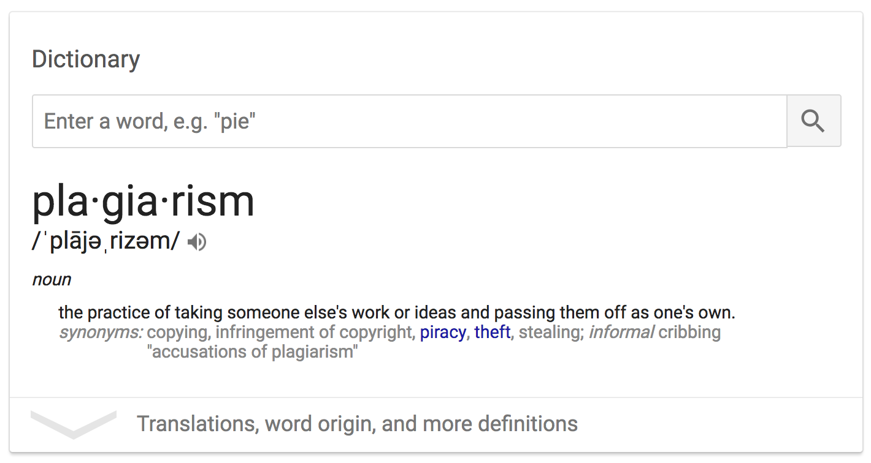

Slide 7
Scenario 0: self-reuse, not in a class
You wrote a program that solved a particular problem as part of a project you’re working on for fun
Later on for a different project you’re working on for fun, you need to solve the same problem
Questions:
Can you reuse the code?
Does it matter what the code does?
Do you need to attribute the code?

Slide 8
Scenario 1: self-reuse, in-class work
You wrote a program that solved a particular problem for a previous assignment in a course
Later on for a project you’re working on for fun, you need to solve the same problem
Questions:
Can you reuse the code?
Does it matter what the code does?
Do you need to attribute the code?

Slide 9
Scenario 2: self-reuse, same course
You wrote a program that solved a particular problem for a previous assignment in a course
In a later assignment for that same course, you need to solve the same problem as part of a larger process
Questions:
Can you reuse the code?
Does it matter what the code does?
Do you need to attribute the code?
Does it matter if you copy/paste or import it?

Slide 10
Scenario 3: self-reuse, different course
You wrote a program that solved a particular problem for a previous assignment in a course
In an assignment for a different course, you need to solve the same problem
Questions:
Can you reuse the code?
Does it matter what the code does?
Do you need to attribute the code?
Does it matter if it’s the whole assignment, or just one part?

Slide 11
Scenario 4: self-reuse, academic work →
You wrote a program that solved a particular problem for an assignment in a course
You later get a job as a software engineer, and you need to solve the same problem
Questions:
Can you reuse the code?
Does it matter what the code does?
Do you need to attribute the code?
Does it matter if it’s the whole assignment, or just one part?

Slide 12
Scenario 5: professors and TAs
You are trying to solve a particular problem for an assignment in a course, but you are stuck
You ask the professor or TA for advice, they walk you through how to implement one of the functions
Questions:
Can you use the code?
Does it matter what the code does?
Do you need to attribute the code?

Slide 13
Scenario 6: peers
You are trying to solve a particular problem for an assignment in a course, but you are stuck
You ask a friend who took the class last year, they walk you through how to implement one of the functions
Questions:
Can you use the code?
Does it matter what the code does?
Do you need to attribute the code?

Slide 14
Scenario 7: online sources
You are trying to solve a particular problem for an assignment in a course, but you are stuck
You look online to try to understand a concept, someone walks through how to implement one of the functions
Questions:
Can you use the code?
Does it matter what the code does?
Do you need to attribute the code?

Slide 15
Common online Q&A resources

Slide 16
Demo: using StackOverflow

Slide 17
How to attribute online code
# ------- START ATTRIBUTED CODE SECTION -------
# Code created with the help of Stack Overflow
# https://stackoverflow.com/questions/49581417
#
# Question by Alden:
# https://stackoverflow.com/users/9378177/alden
#
# Answer by CD Lane:
# https://stackoverflow.com/users/5771269/cdlane
# ...THE ACTUAL CODE GOES HERE...
# --------- END ATTRIBUTED CODE SECTION --------

Slide 18
Discussion
For educational purposes, does copyright matter?
Isn’t everything covered by “fair use”?

Slide 19
Rules for code reuse
Always attribute
Only use code you actually understand
If it’s for a course, talk to the professor first
Understand the license, e.g. for StackOverflow

Slide 20
Activity: code reuse
With your group, pick a simple game (like
Use online resources to find a working python implementation
One partner: make a new repl containing the code you found, add your partners as collaborators
Write up the attribution
Make sure that you understand each piece of the code (add lots of comments!)

Slide 21
Show and tell
What did you find?
How does it work?

Slide 22
Version control
A system that records changes to files over time
Allows you to restore specific versions later if you need to

Slide 23
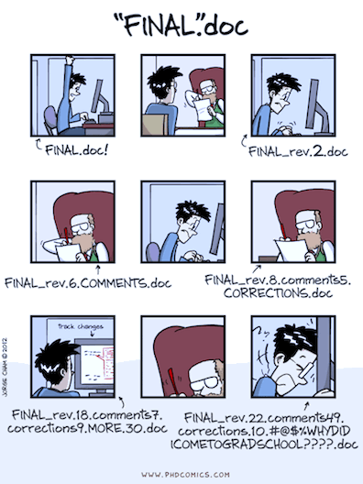
A common (terrible) pattern
(thanks to phdcomics.com for being hilarious
and Ben Baumer for the following slides)

Slide 24
Slightly better
2019-07-25_1151am_hw5.py
2019-07-25_0232pm_hw5.py
2019-07-25_0603pm_hw5.py
2019-07-25_0947pm_hw5.py
2019-07-25_1153pm_hw5.py
2019-07-26_0117am_hw5.py
...but what if you have multiple files working together?

Slide 25
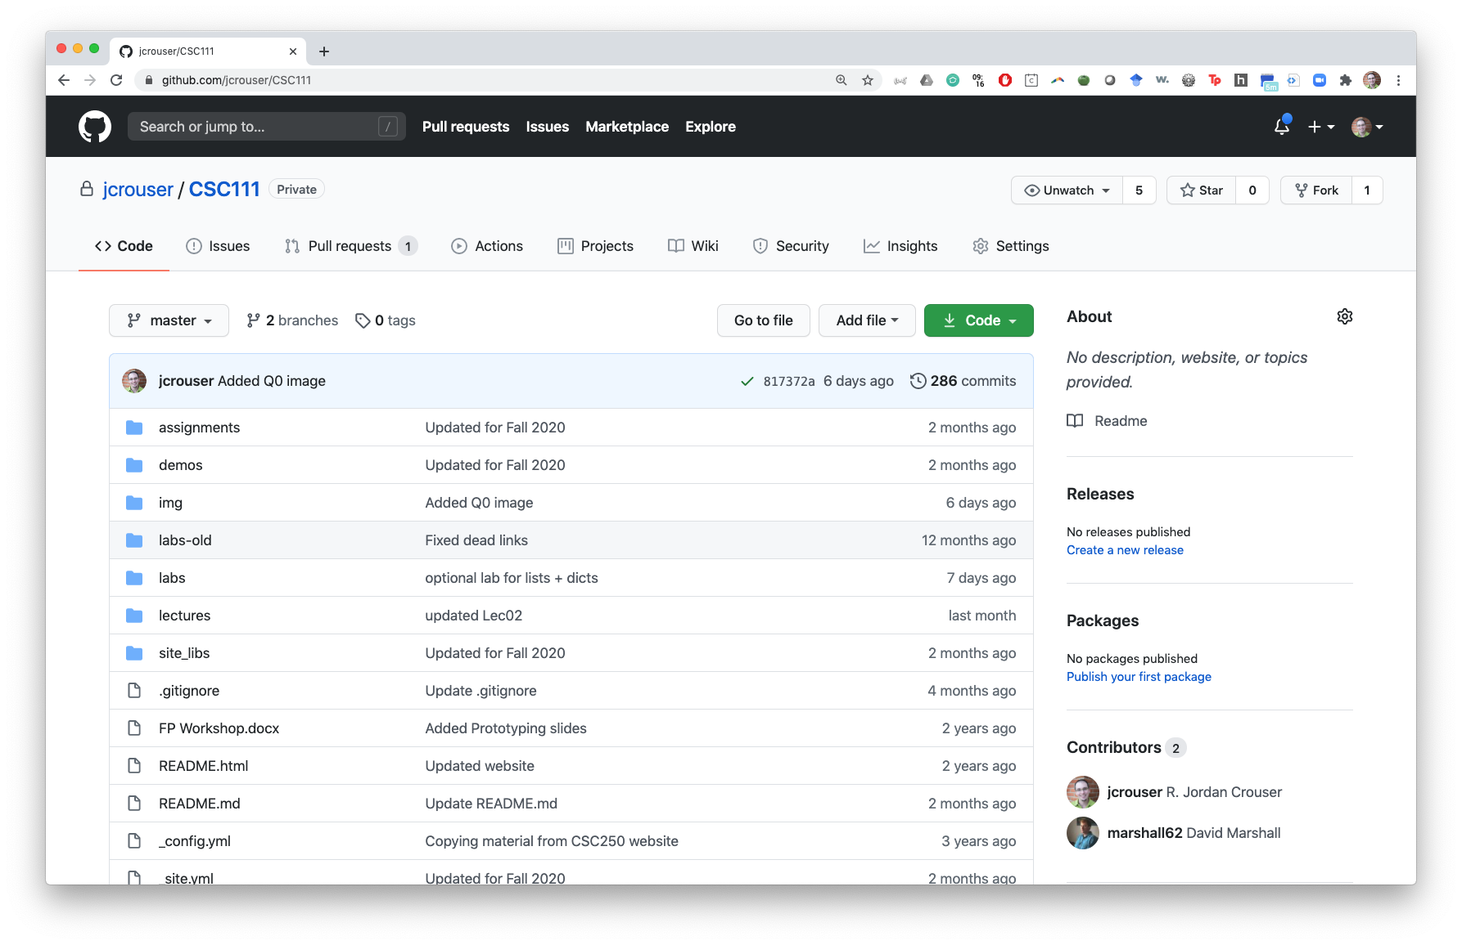
Best: version control tools like git

Slide 26
Version control 101
Start with a base version
Instead of saving lots of copies, just save just the changes (and note where they belong)
Think of it like a tape: can rewind & play back each change
Image source: software-carpentry.org

Slide 27
Collaboration with version control
Multiple people can contribute changes
“Playing back” different sets of changes = different versions of the document
Image source: software-carpentry.org

Slide 28
Git and GitHub
git
Command-line interface (CLI) that does the work*
OS-specific installation
Needed to use GitHub
git pull, git push, etc.
hosting for git projects
strong community
additional tools to enhance collaboration
a common location to share your work
* you also have a CLI for python!

Slide 29
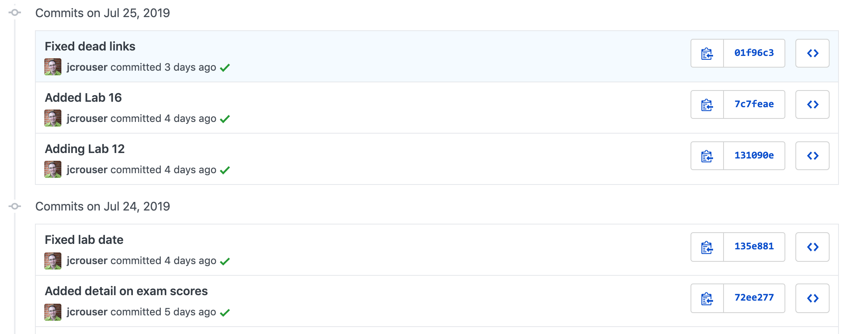
Commits

Slide 30
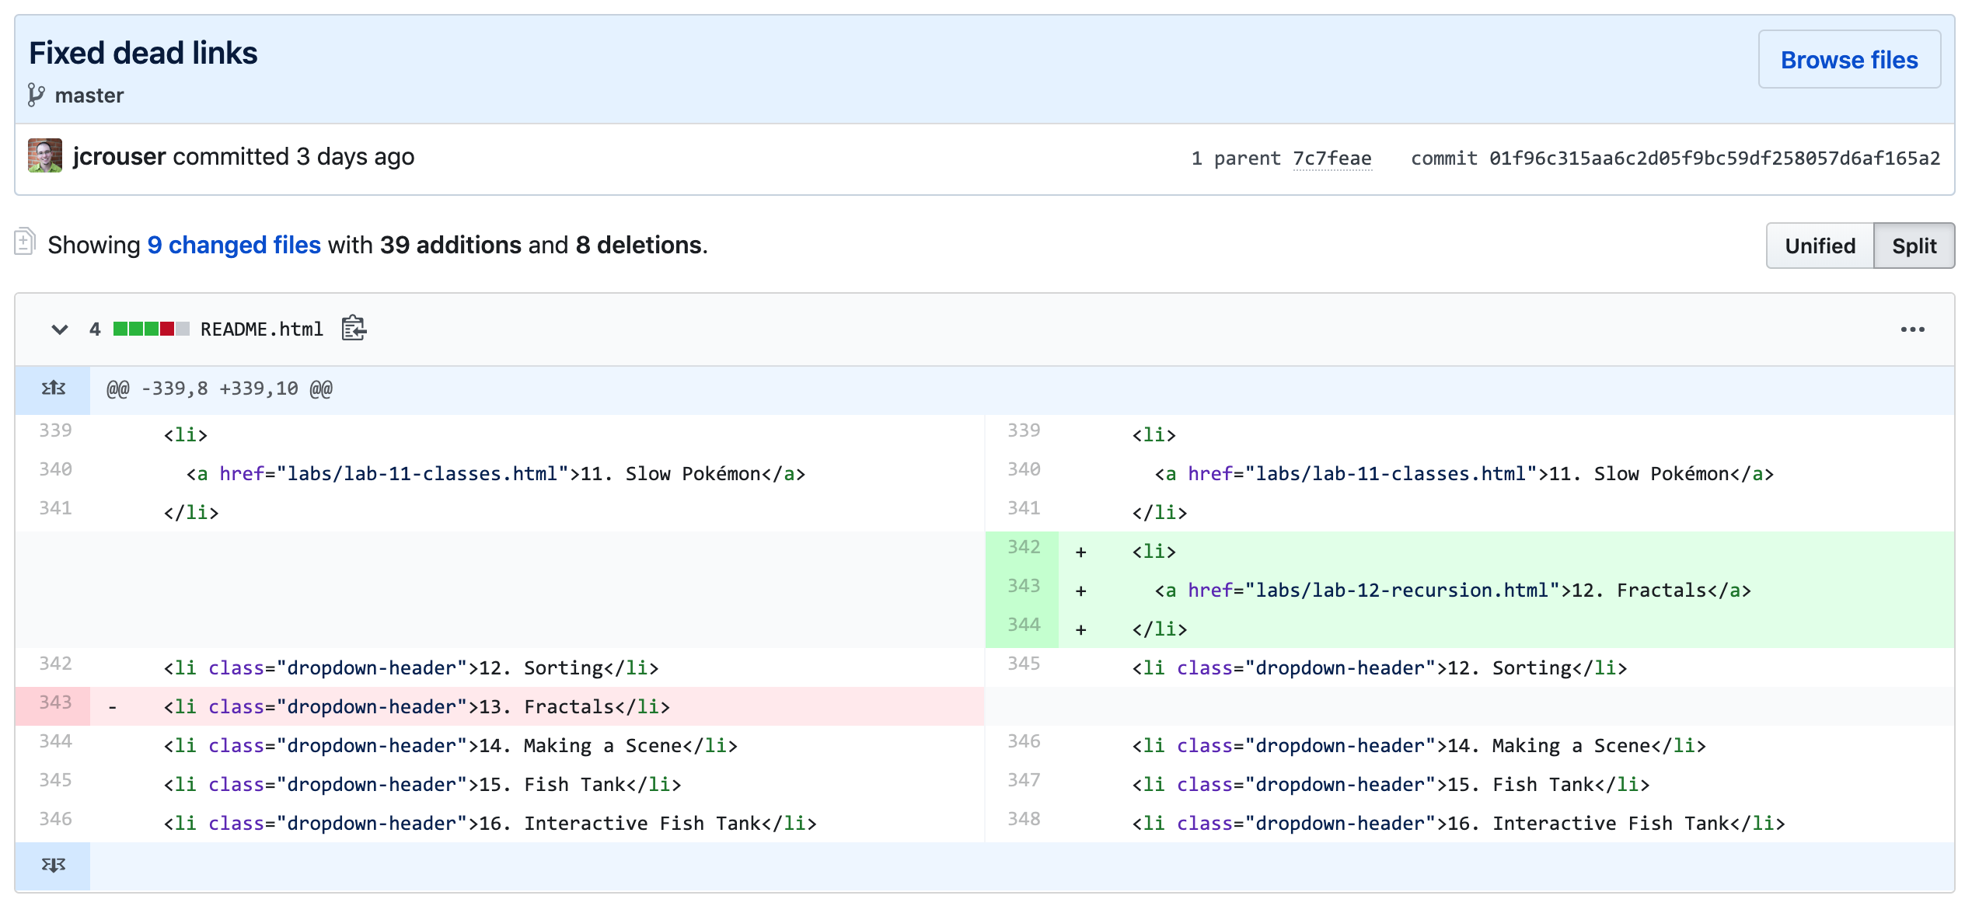
Diff (“difference”)

Slide 31
This seems complicated… why bother?
Automatic tracking of changes
No download/upload/emailing of files
Easy collaboration, with ability to resolve merge conflicts
Searchability
Can track issues, releases, and milestones
Visibility:
GitHub repositories are public
Can request free private repositories for education or research

Slide 32
Alternatives
Pros: easy, seamless
Cons: no simultaneous editing, limited version control (no branches)
Pros: easy, simultaneous editing
Cons: no version control, not actually a .py file (can’t run it)

Slide 33
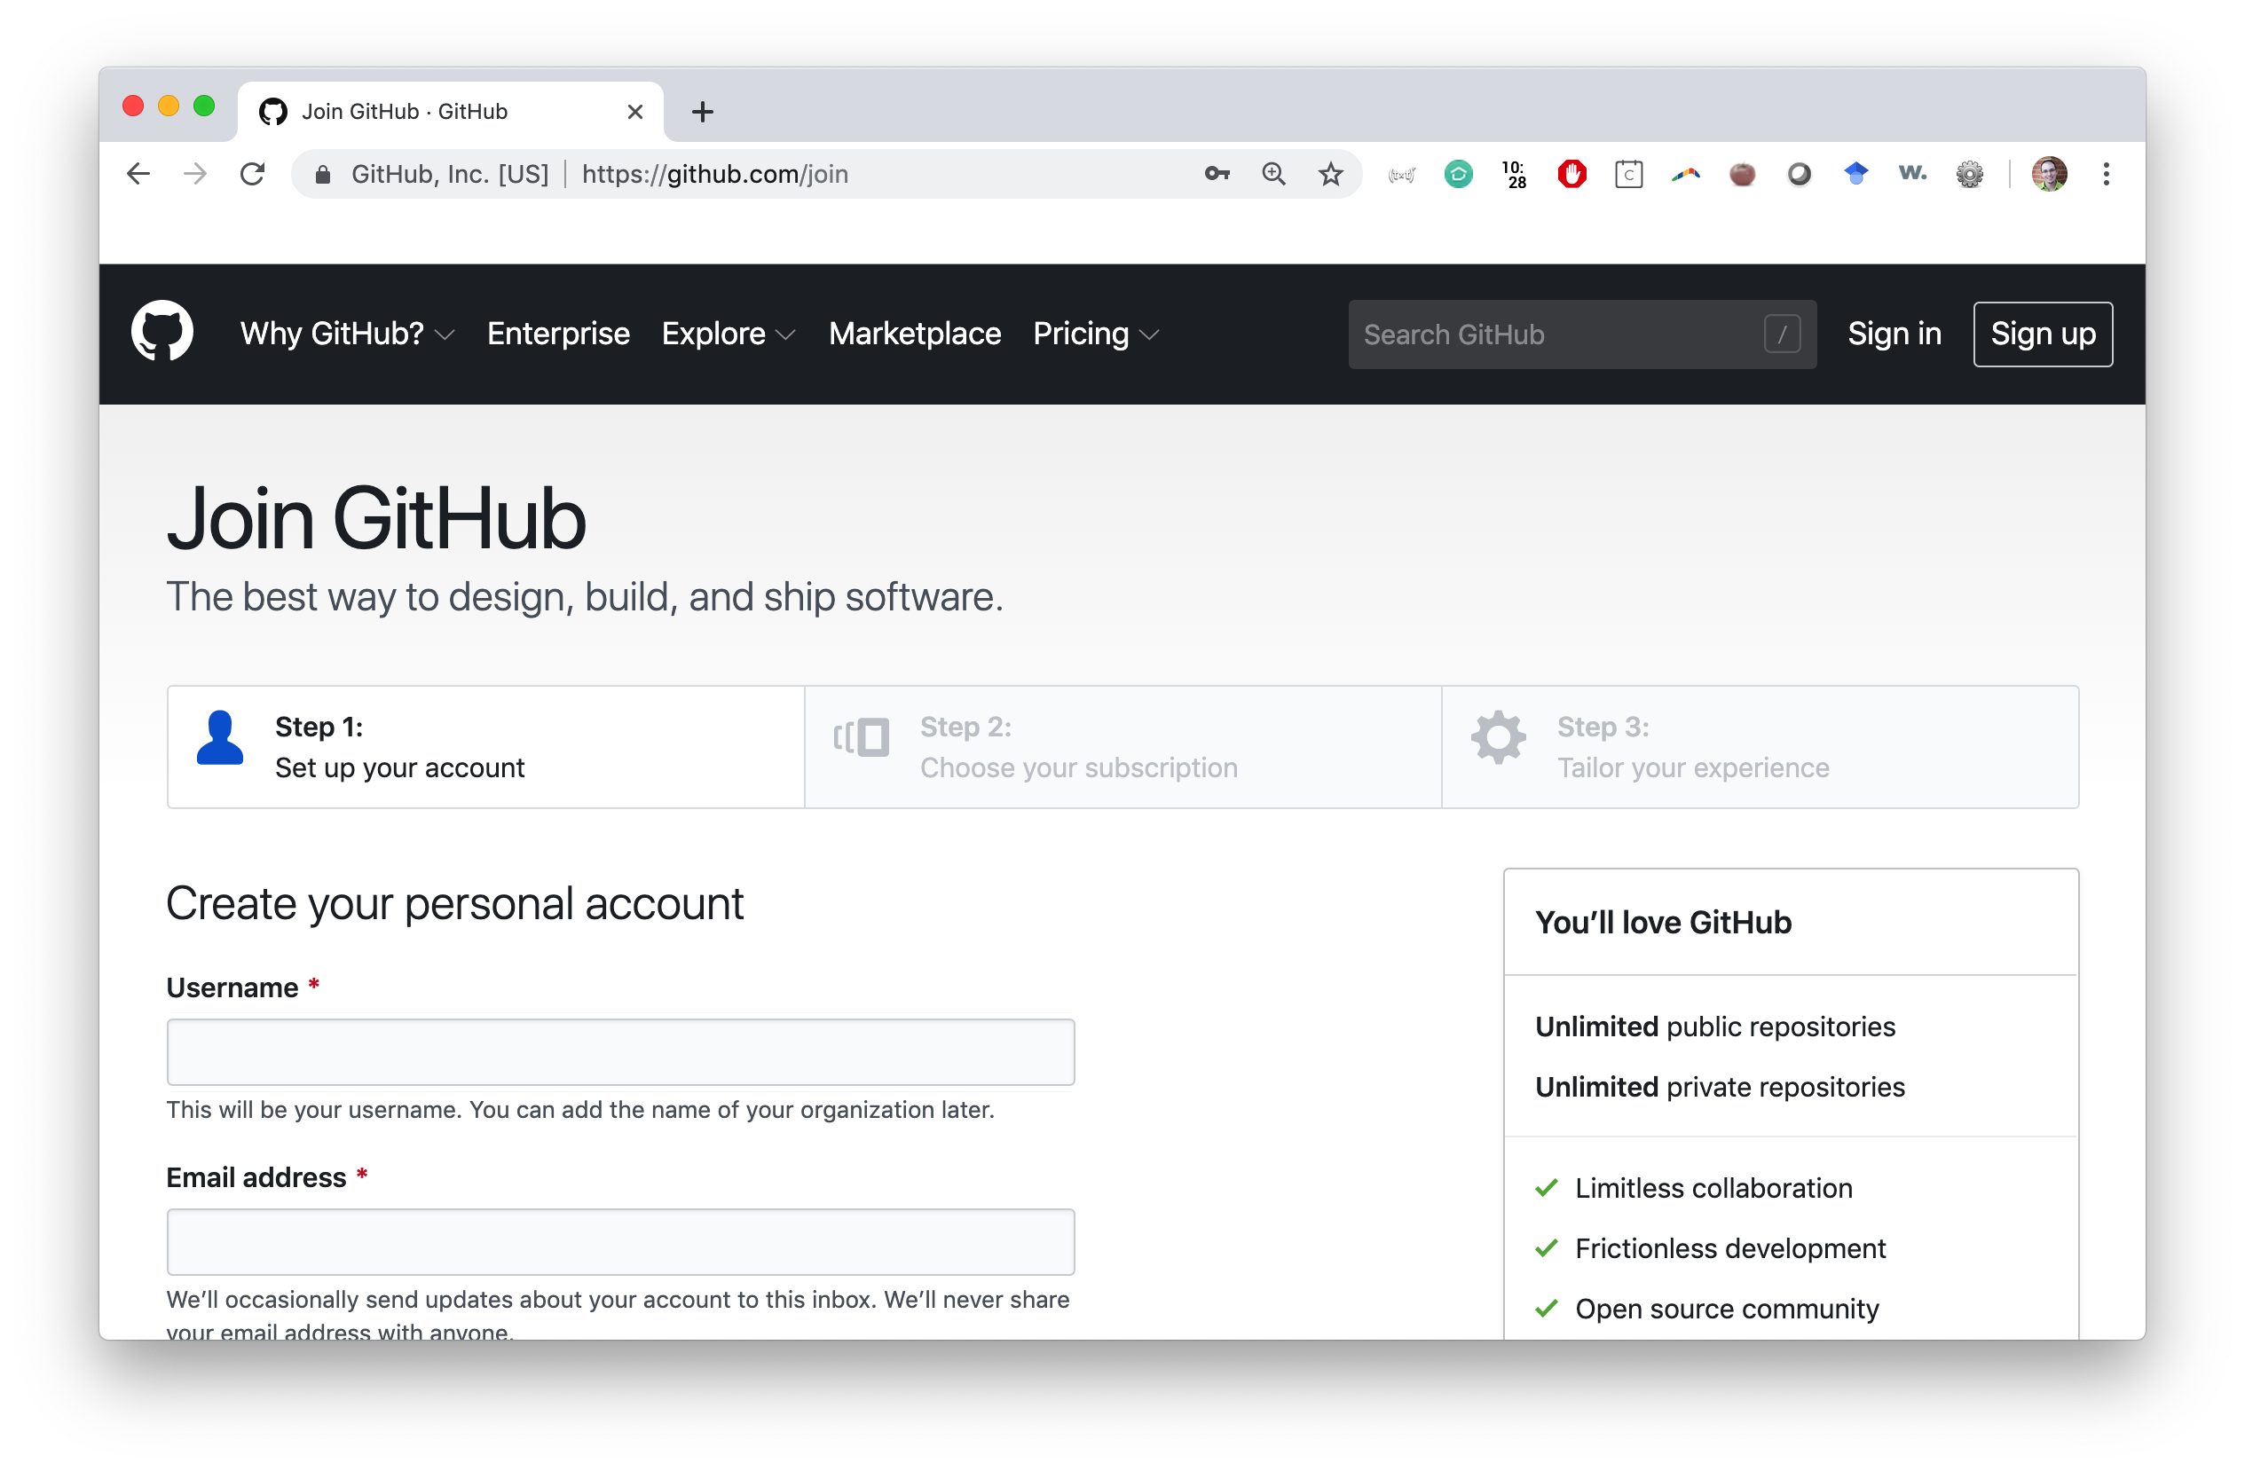
Getting started with git (a walkthrough)
Step 1: go to github.com/join and create an account

Slide 34
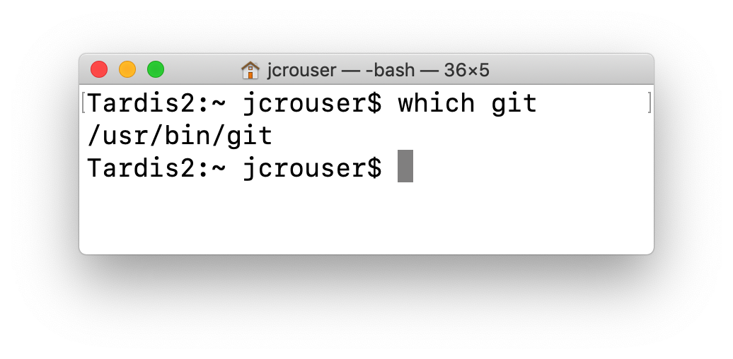
Getting started with git (a walkthrough)
Step 2: make sure git is installed (it should be)
open the Terminal app (not IDLE)
type which git at the prompt and hit return

Slide 35
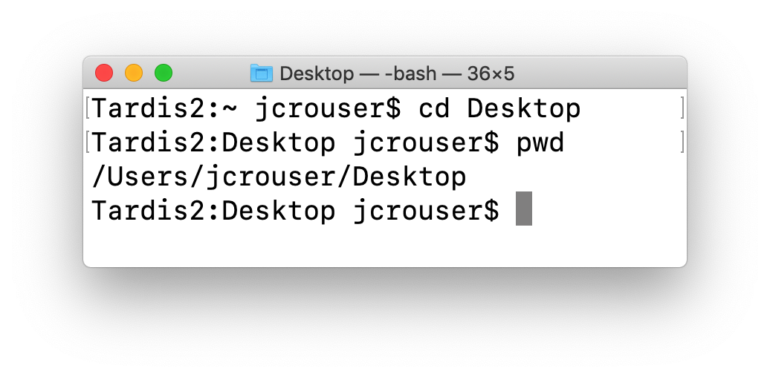
Getting started with git (a walkthrough)
Step 3: navigate to someplace useful, like the Desktop
type cd Desktop (“change directory”) at the prompt and hit return
If you want, type pwd (“print working directory”) to see the path

Slide 36
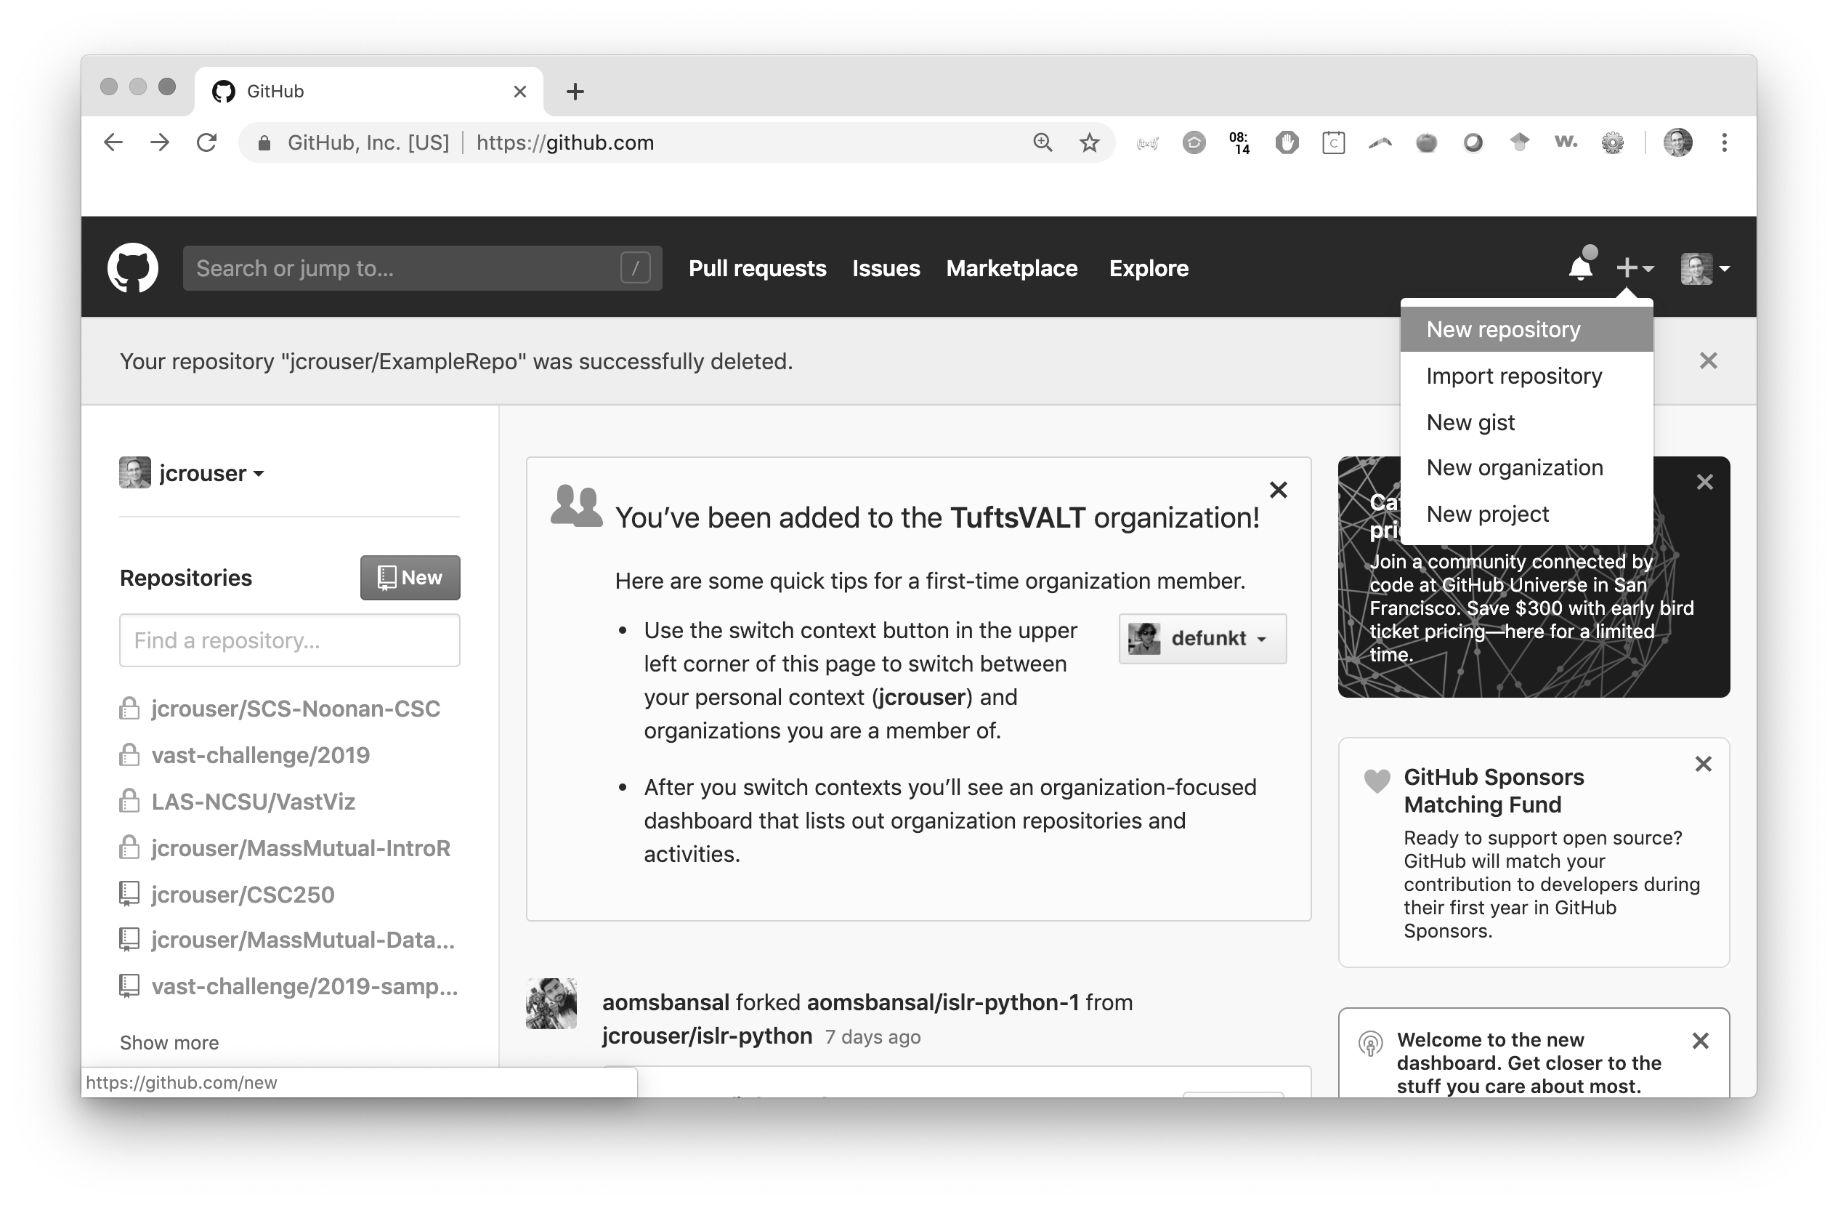
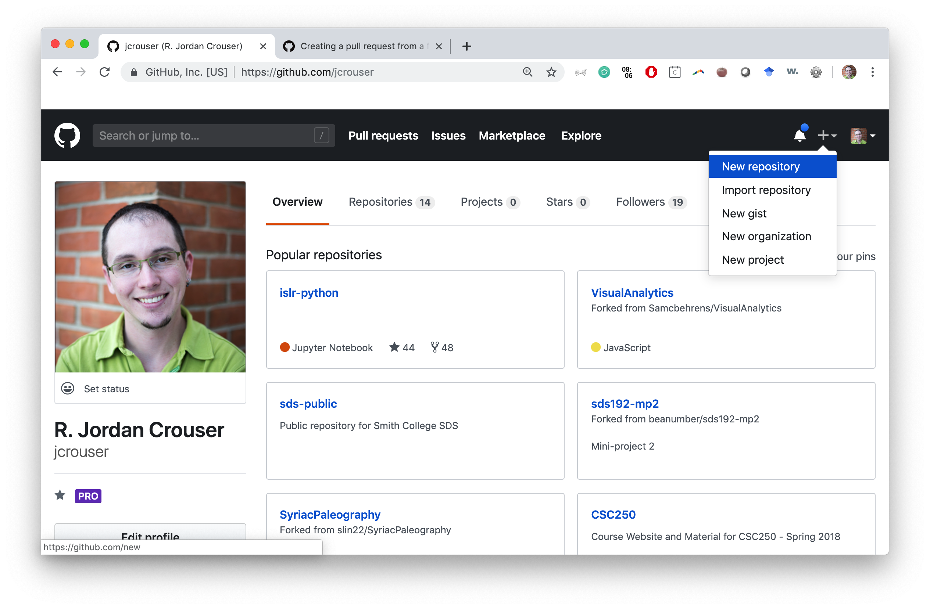
Getting started with git (a walkthrough)
Step 4a: to make a new repository
Click the “+” icon in the upper right corner of the page
Select “New repository” from the menu

Slide 37
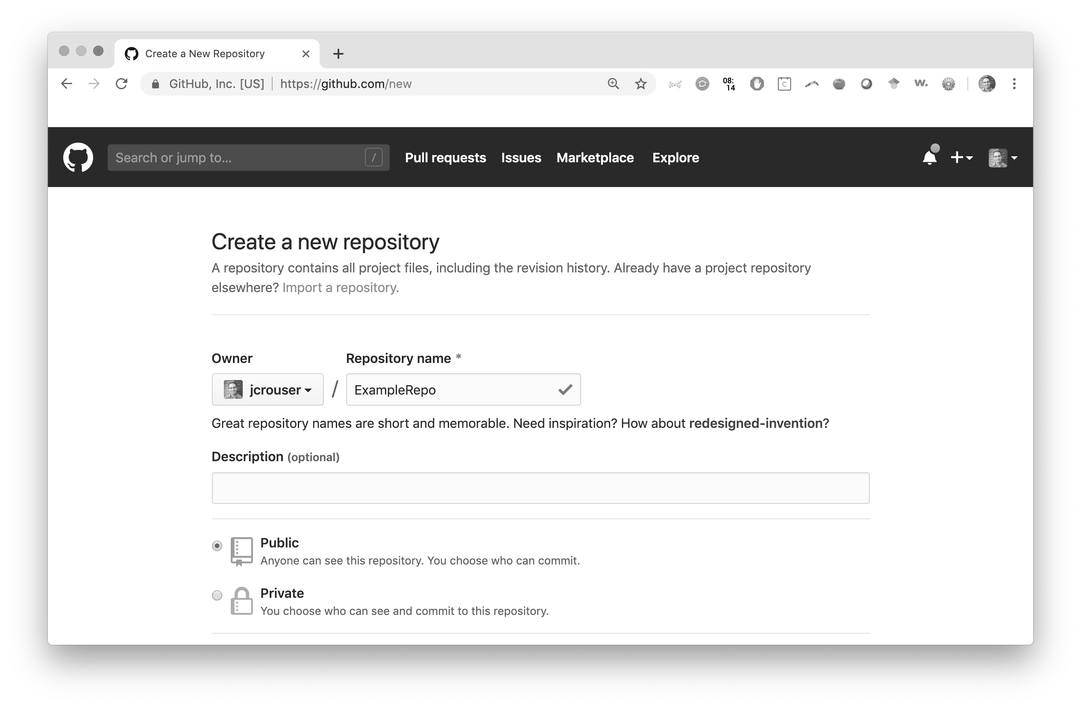
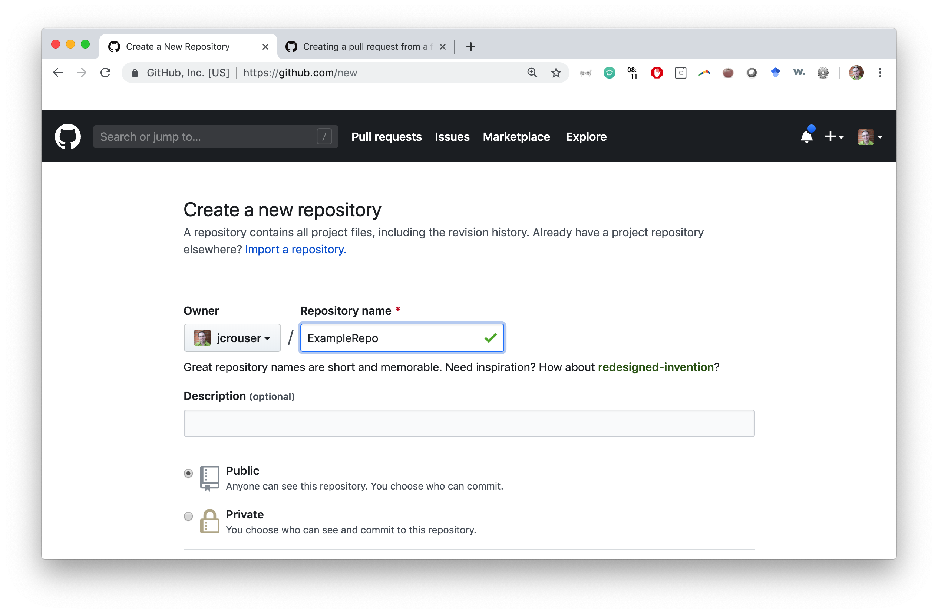
Getting started with git (a walkthrough)
Step 4b: set up your new repository
Give your repository a name (like ExampleRepo)

Slide 38
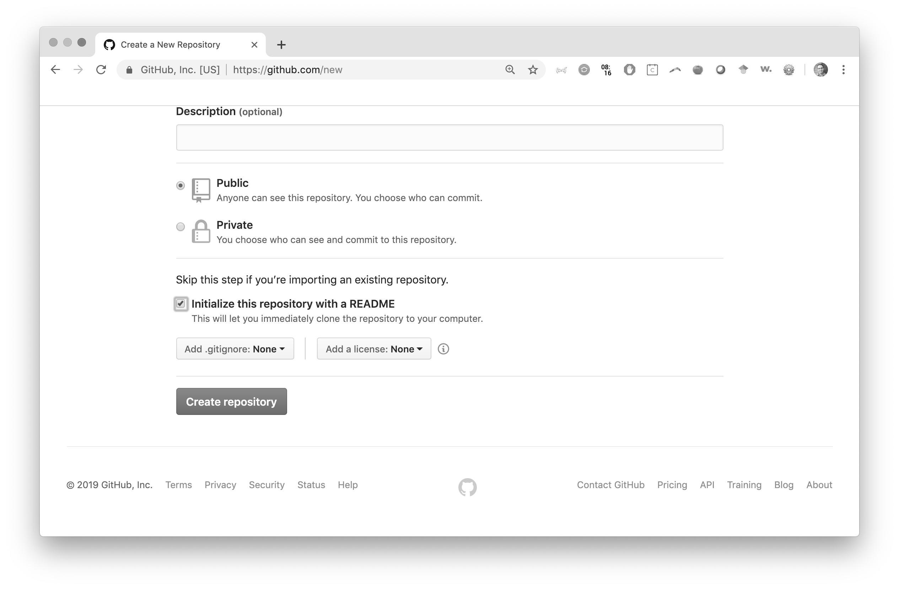
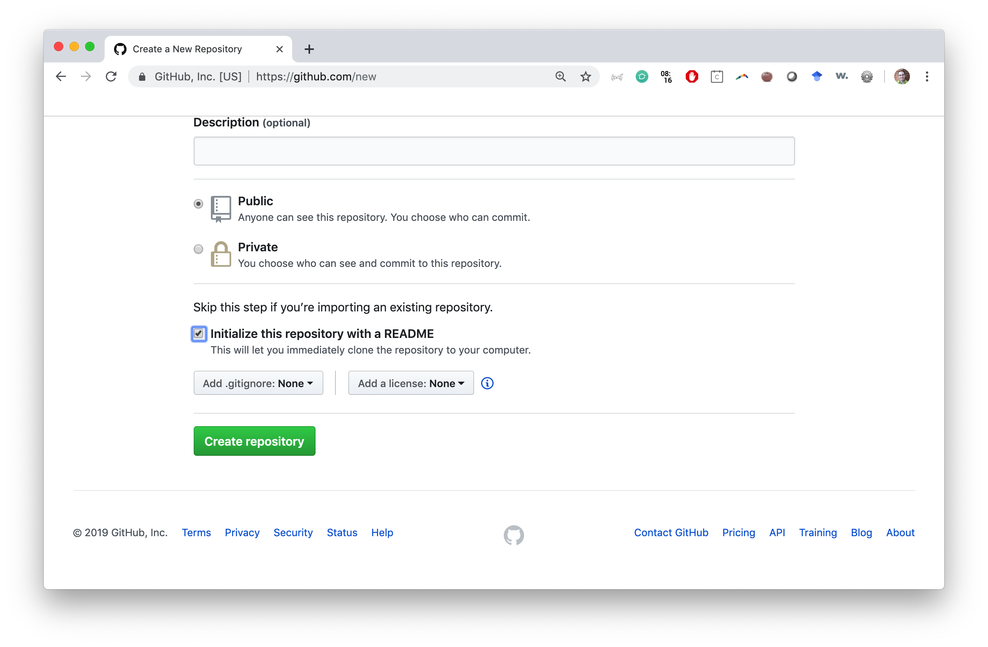
Getting started with git (a walkthrough)
Step 4c: set up your new repository
Check the box “Initialize this repository with a README”
Click the green “Create Repository” button

Slide 39
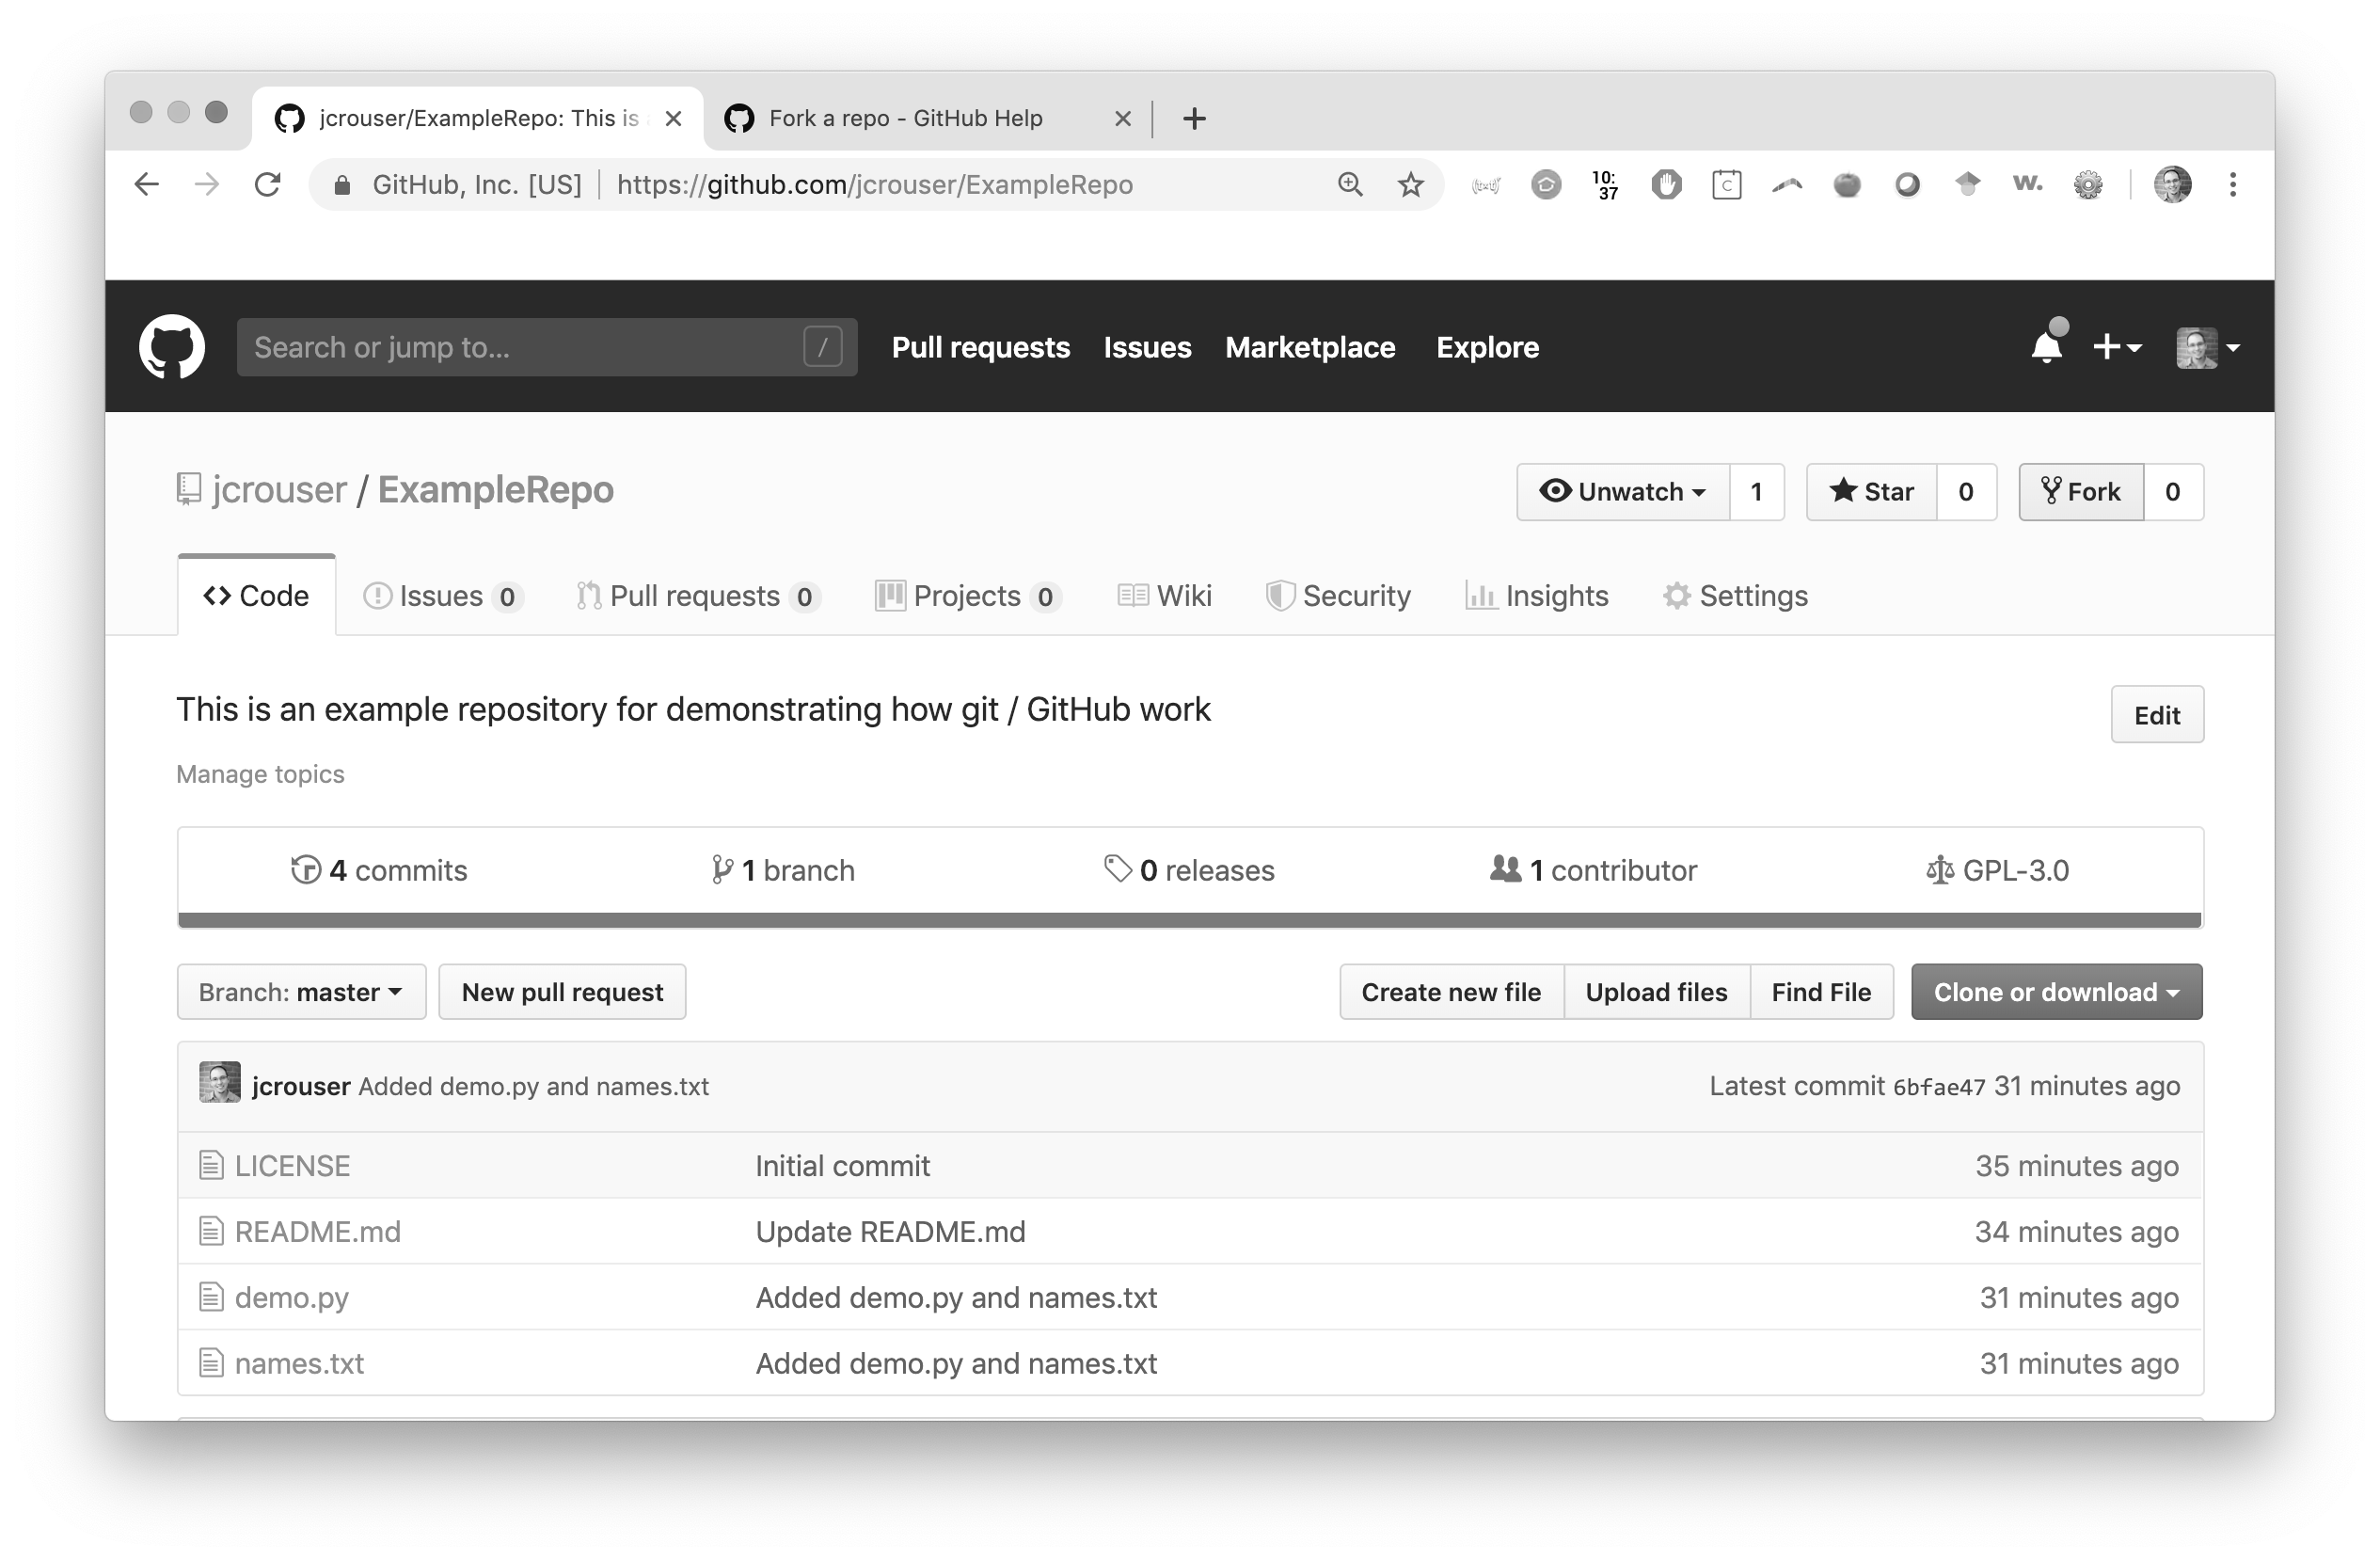
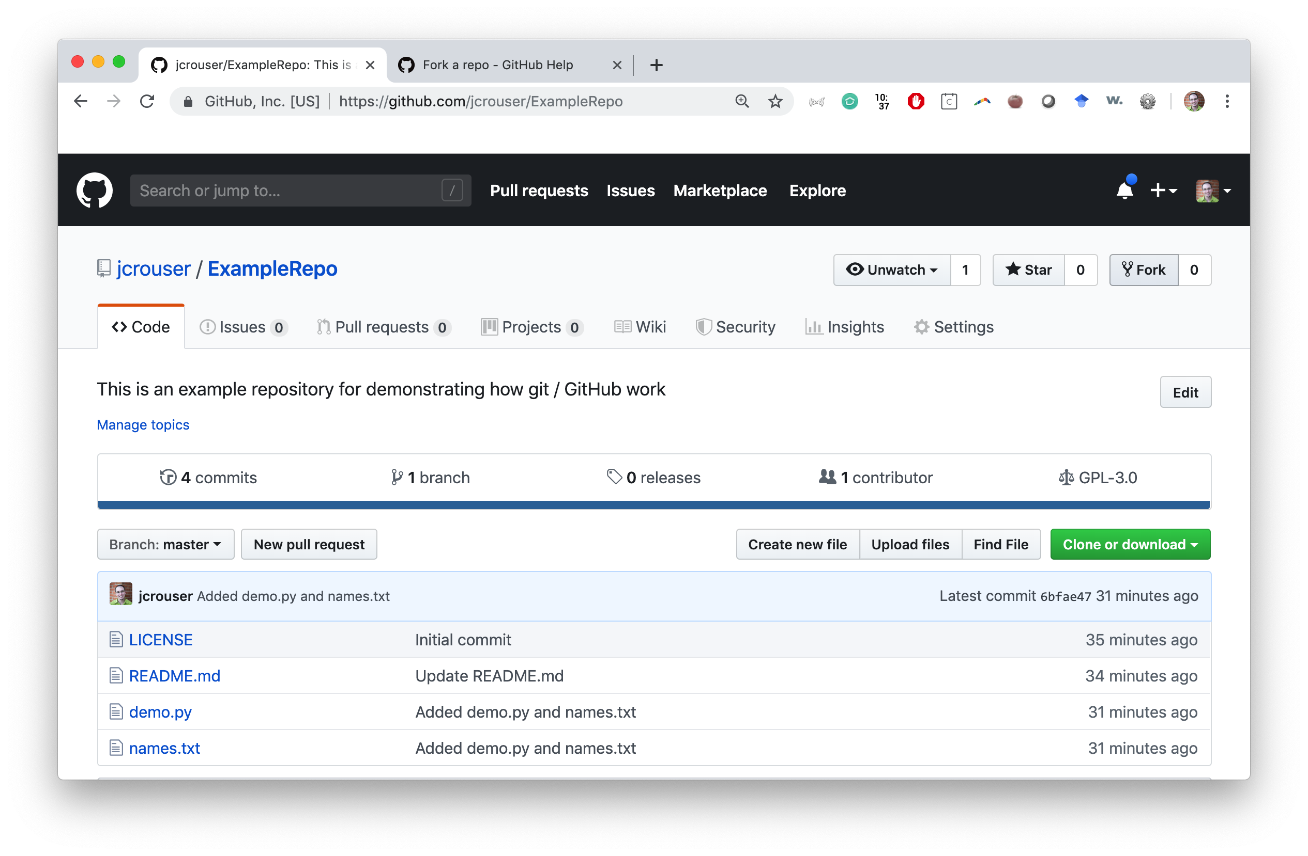
Getting started with git (a walkthrough)
Step 4: to fork an existing repository
navigate to https://github.com/jcrouser/ExampleRepo
Click the Fork button to get a copy of this repo in your own account

Slide 40
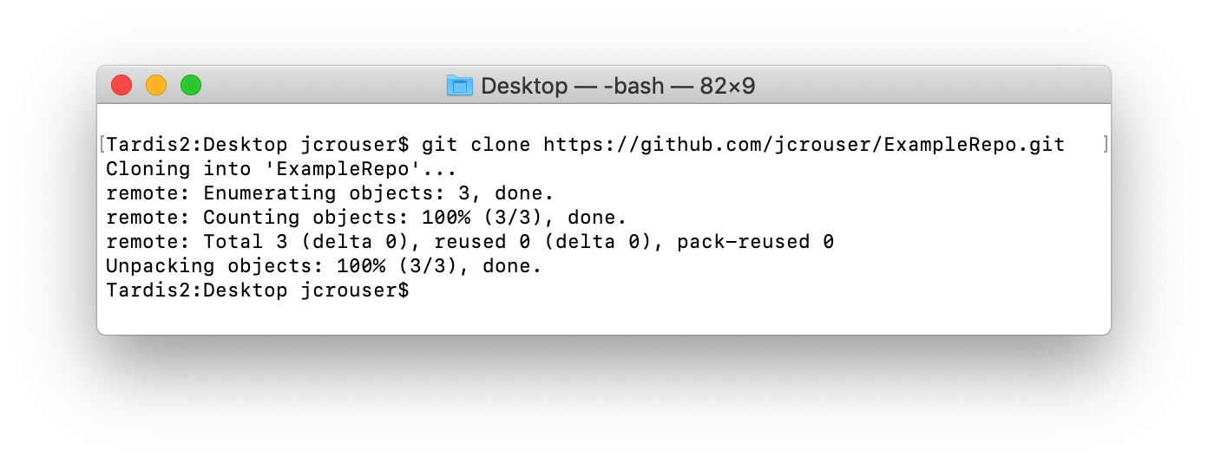
Getting started with git (a walkthrough)
Step 5: clone your repository to your computer
go back to the Terminal (command line)
git clone https://github.com/yourname/ExampleRepo.git
look on the Desktop and you’ll see a new folder called ExampleRepo
take a look inside!

Slide 41
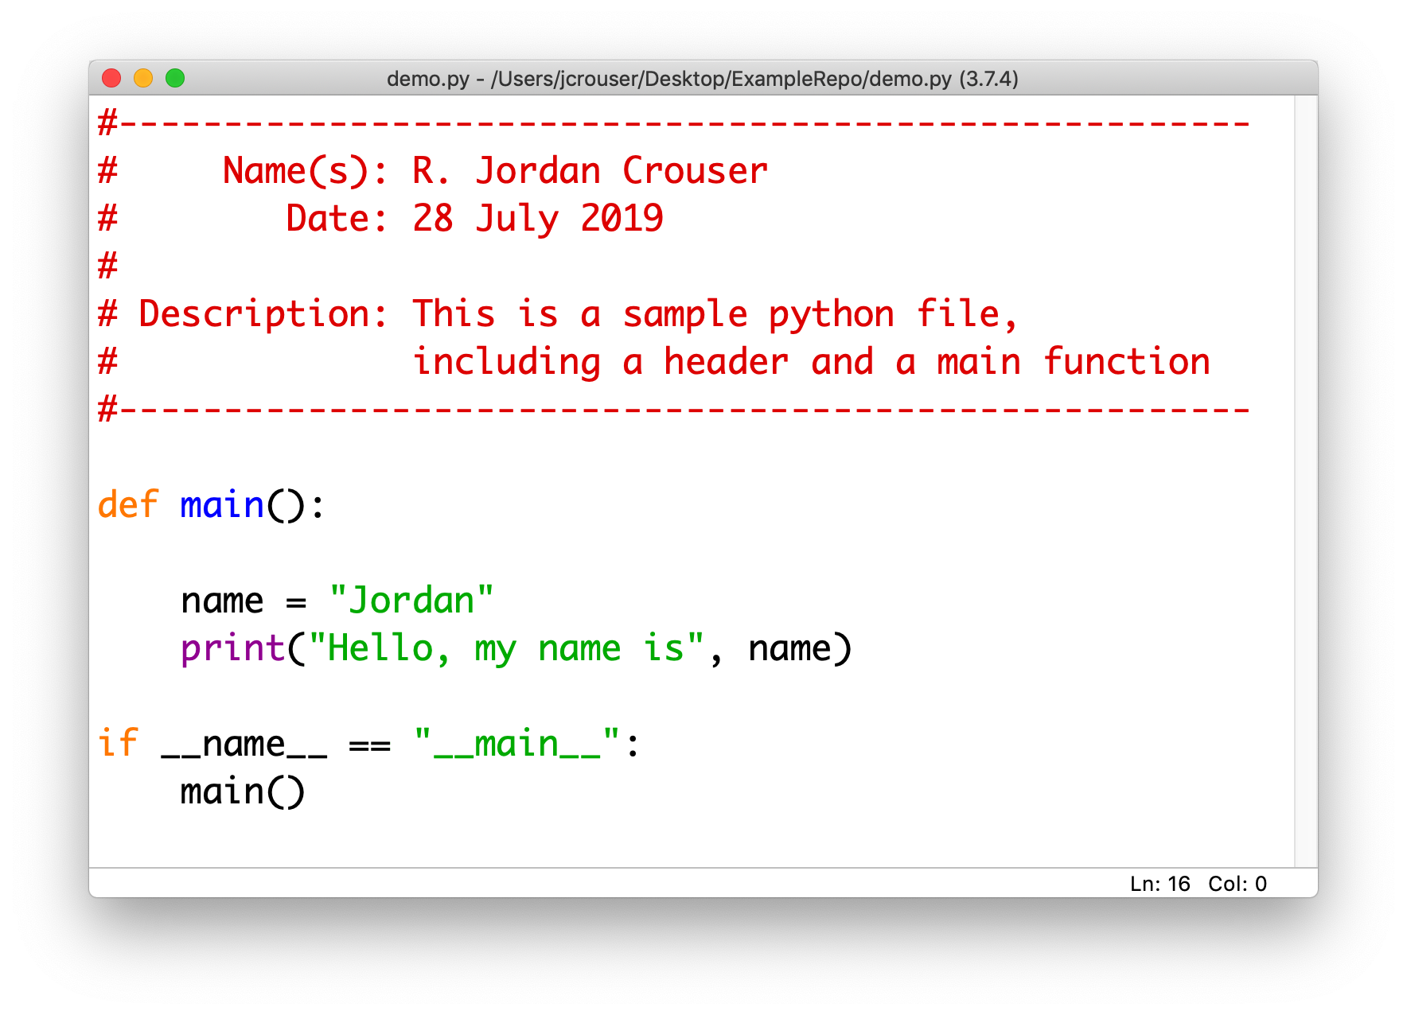
Getting started with git (a walkthrough)
Step 6: adding a new file to the repository
make a file called demo.py
save it in ExampleRepo

Slide 42
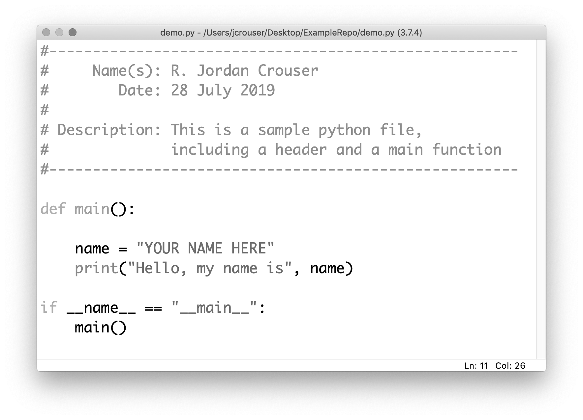

Getting started with git (a walkthrough)
Step 6: make a change to demo.py

Slide 43
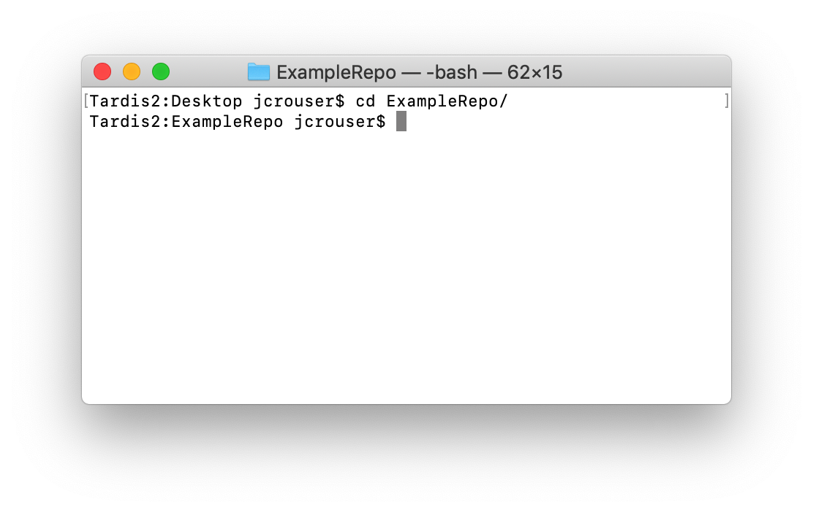
Getting started with git (a walkthrough)
Step 7a: your first commit
type cd ExampleRepo to move into the new directory

Slide 44
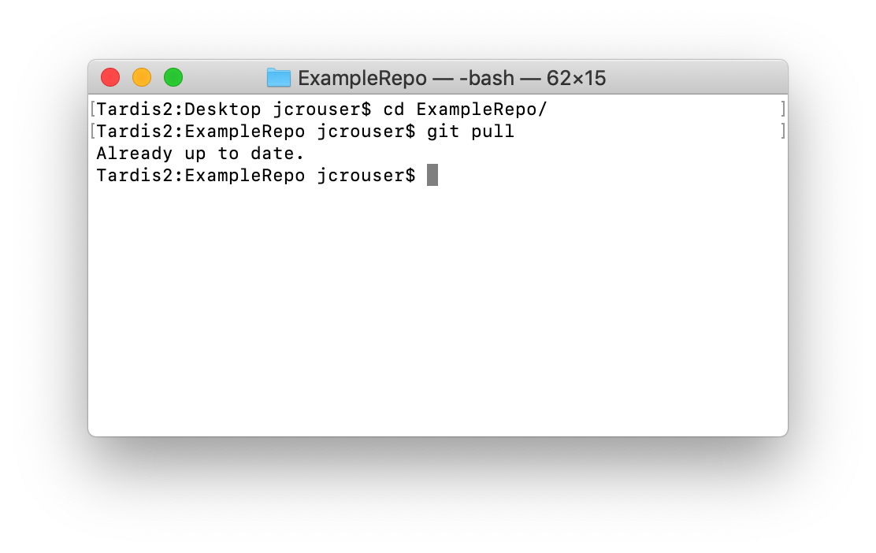
Getting started with git (a walkthrough)
Step 7b: your first commit
type git pull to make sure your local version is up-to-date

Slide 45
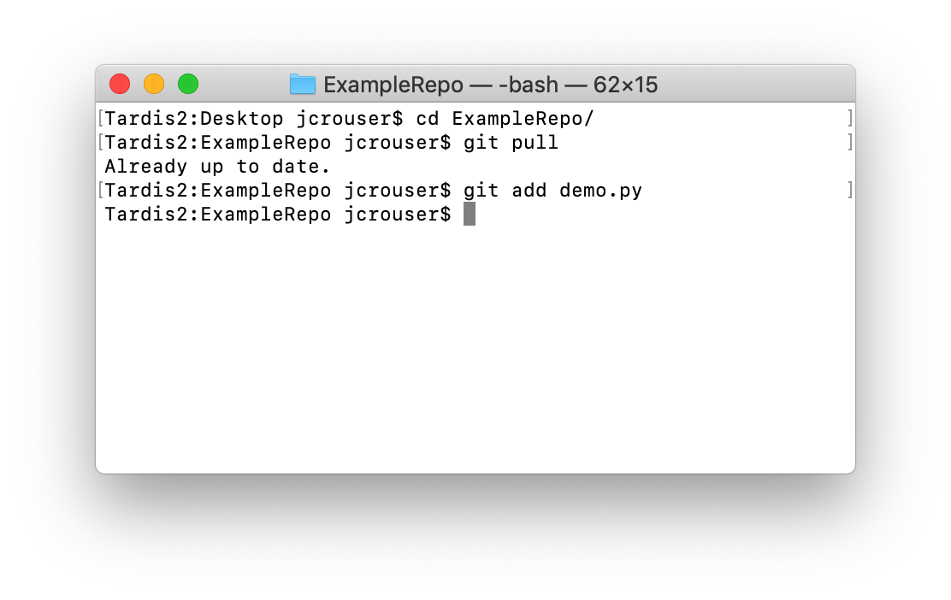
Getting started with git (a walkthrough)
Step 7c: your first commit
type git add demo.py to “stage” your changes

Slide 46
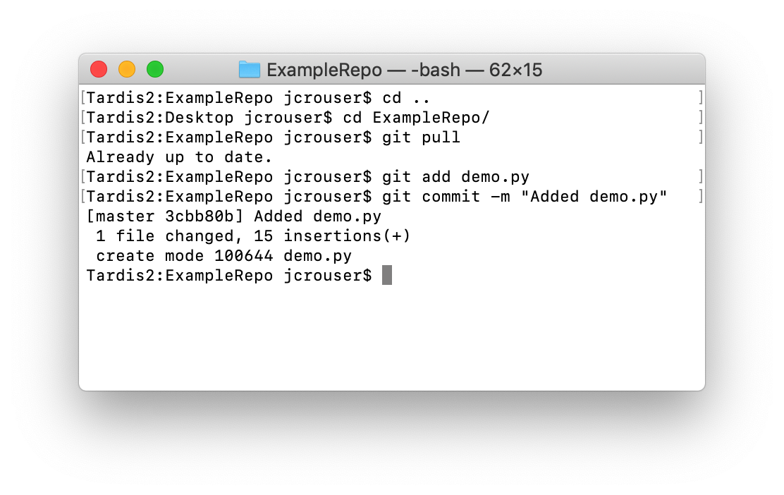
Getting started with git (a walkthrough)
Step 7d: your first commit
type git commit –m “Added demo.py” to commit the changes, including a message about what you did

Slide 47
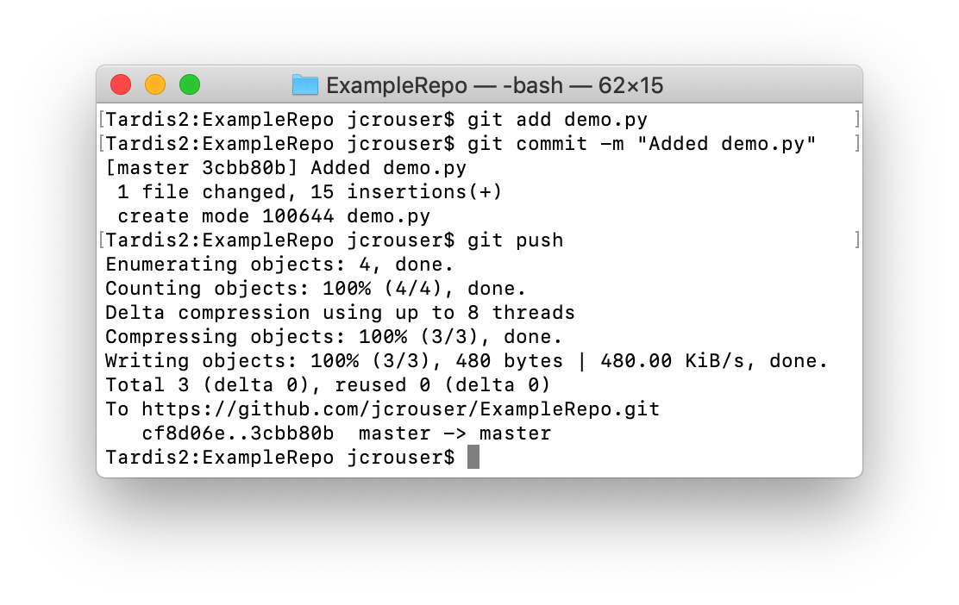
Getting started with git (a walkthrough)
Step 7e: your first commit
type git push to push the changes to the repository

Slide 48
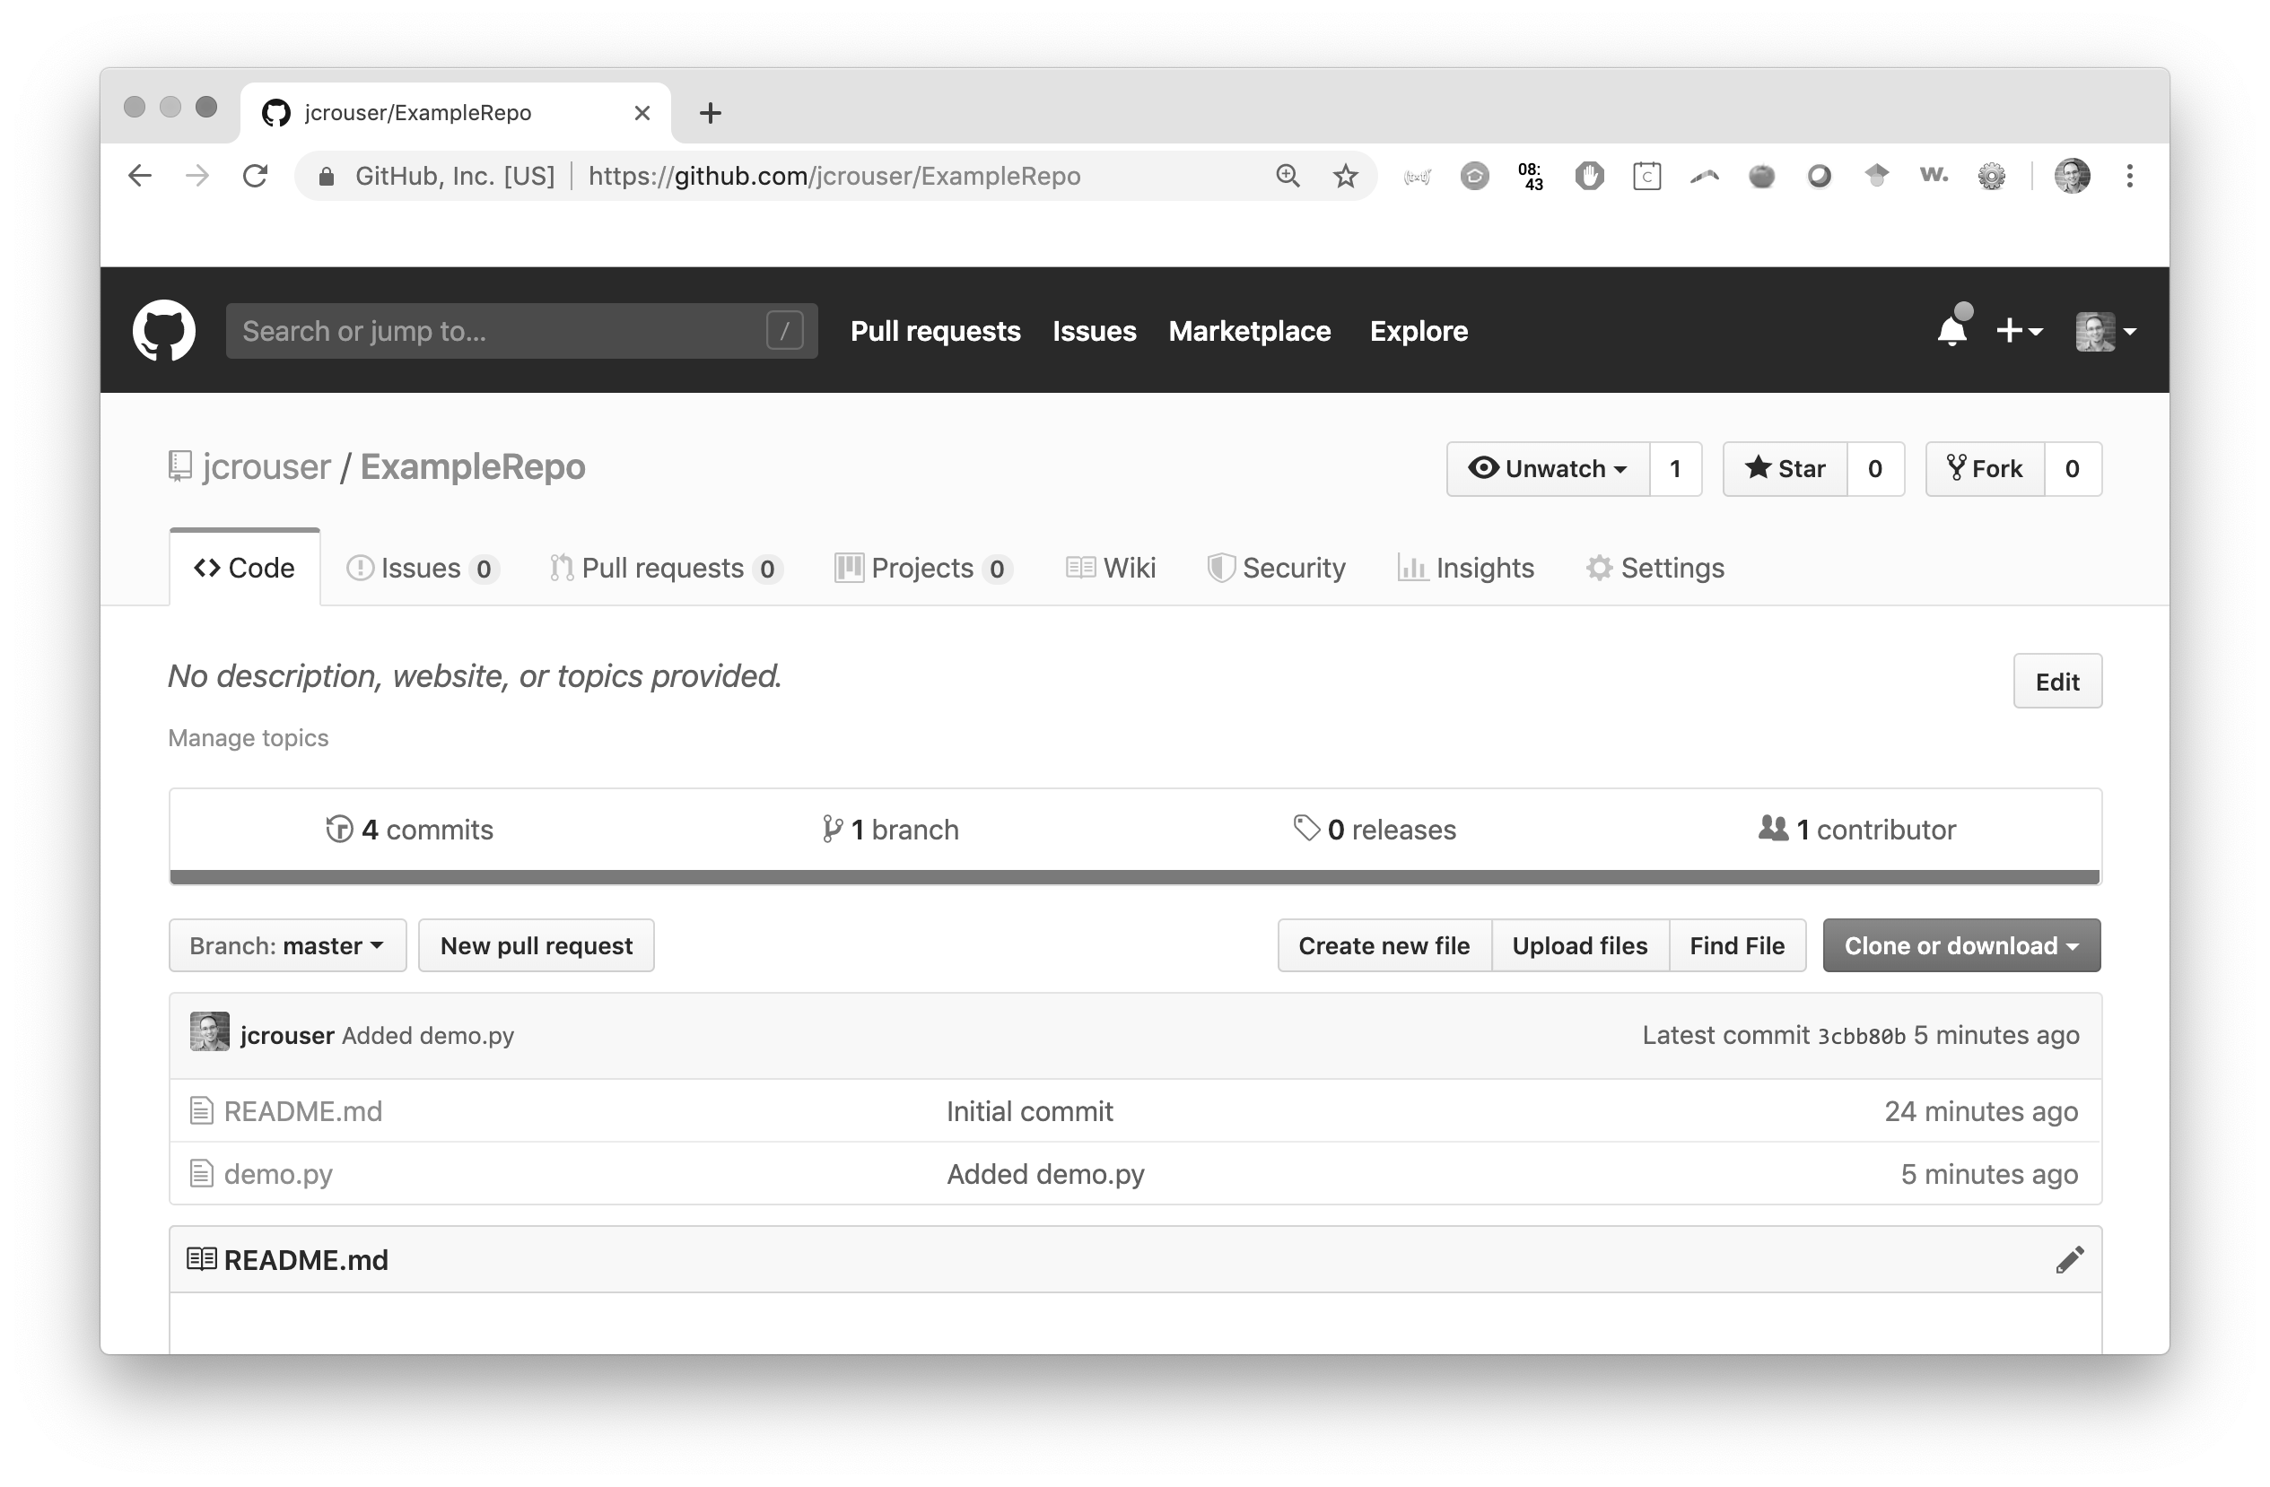
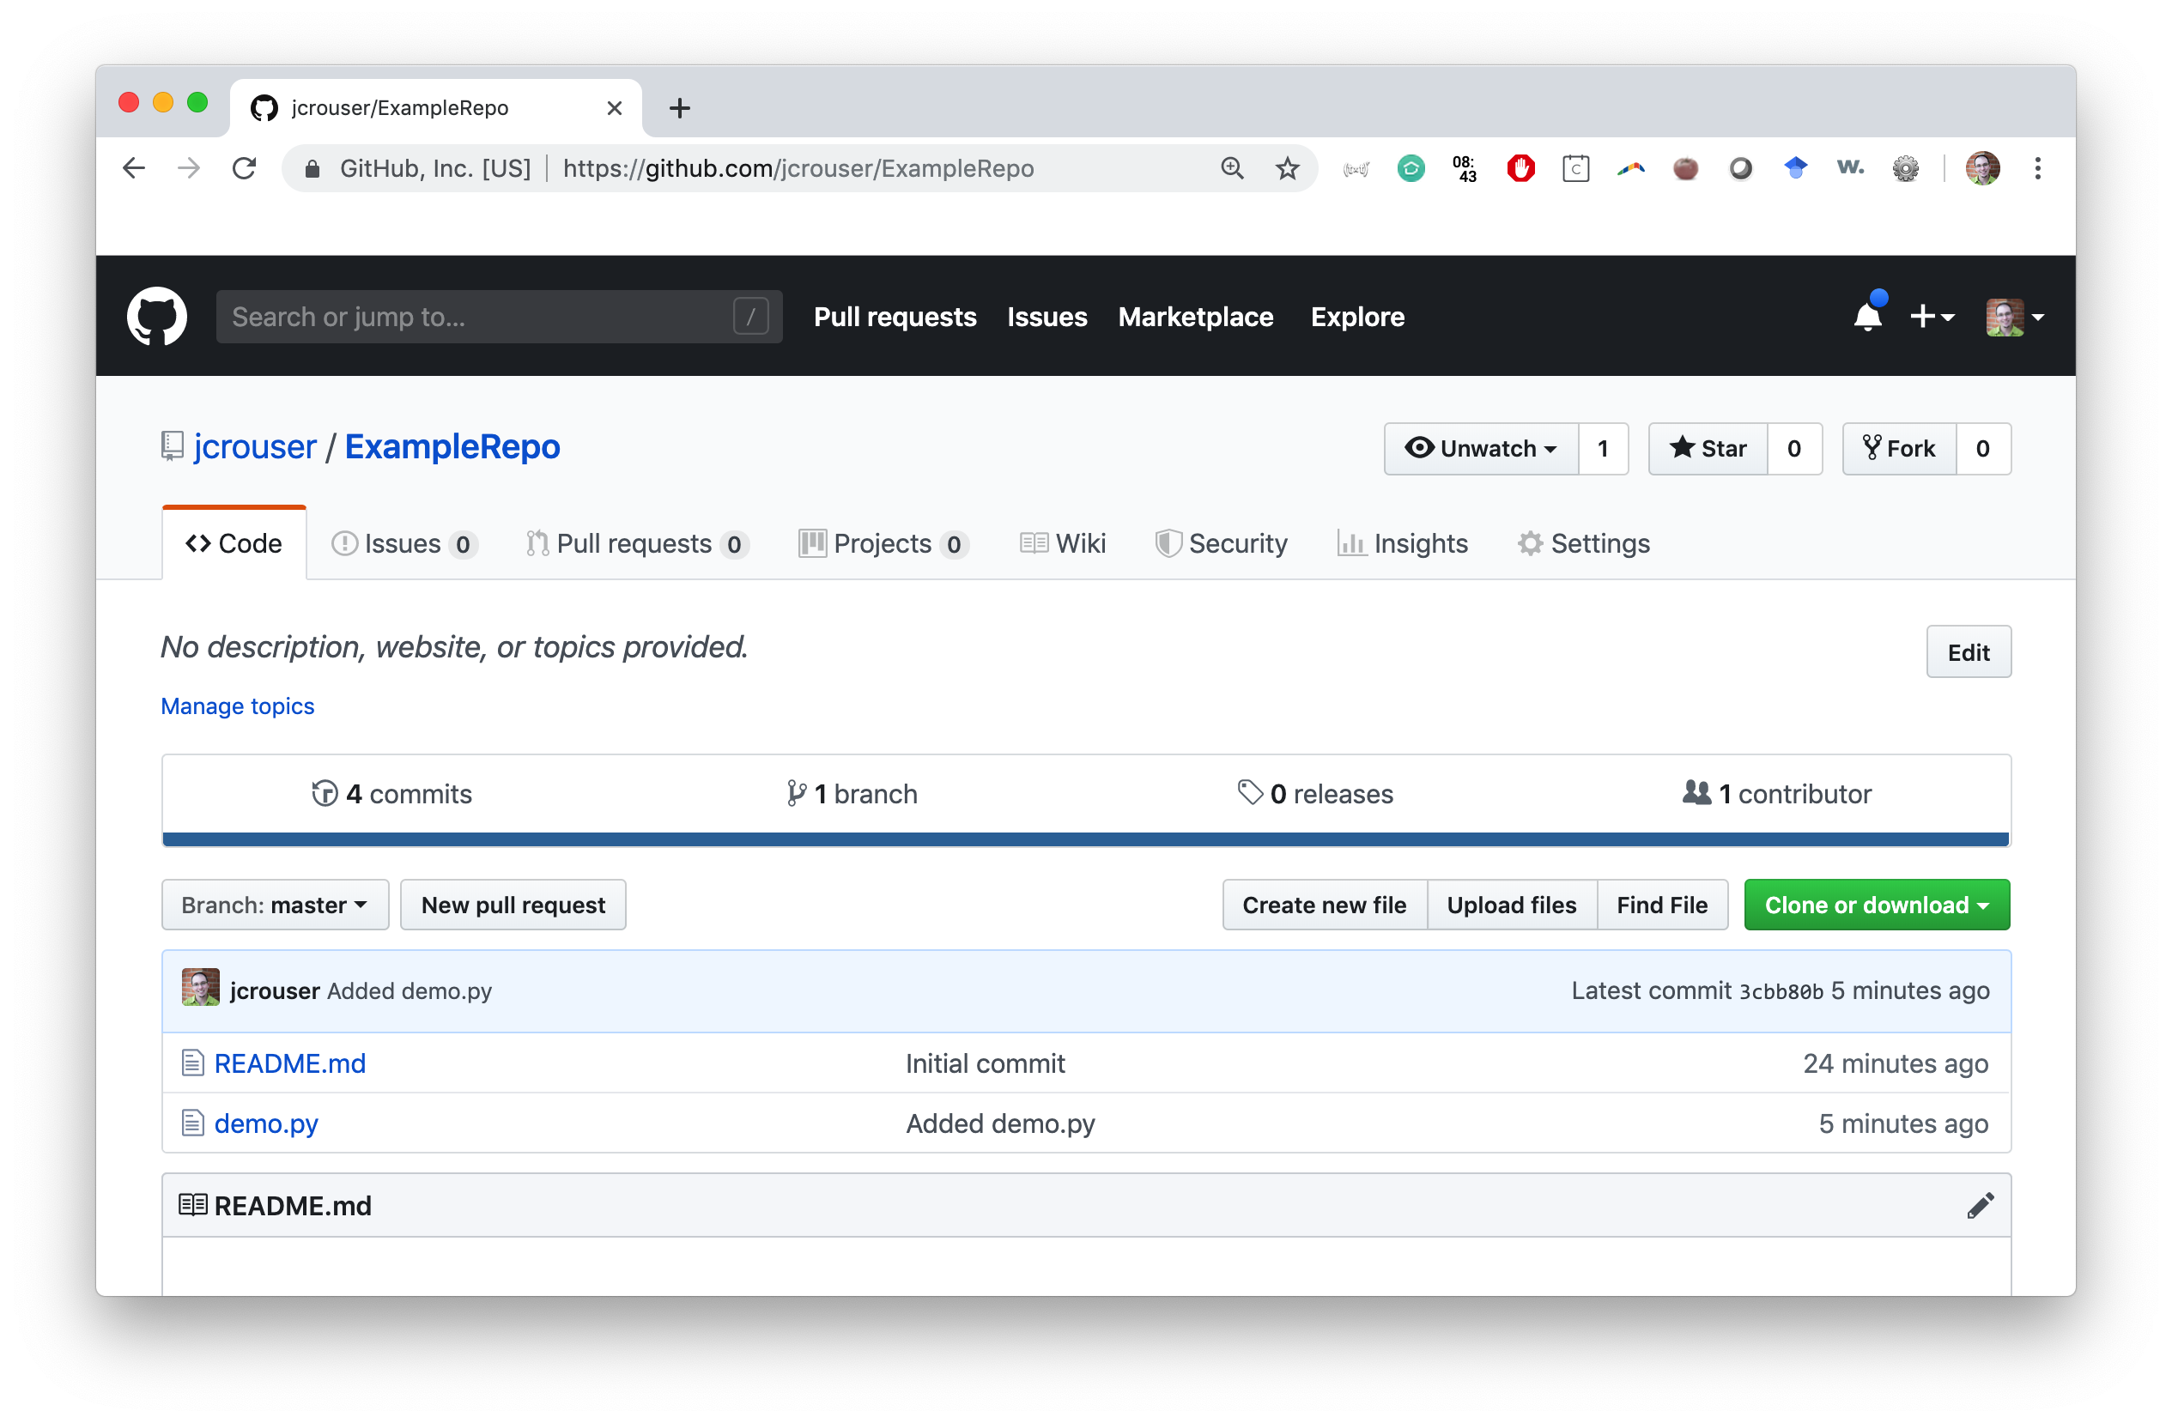
Getting started with git (a walkthrough)
Step 8: go take a look at your repository!

Slide 49
Basic git procedure
pull any recent changes (git pull)
make edits on your computer
commit your local changes (git add / git commit)
this step might be repeated many times
pull again to avoid merge conflicts (git pull)
push your commit(s) to GitHub (git push)

Slide 50
GitHub advice
This is all you really need to know for now
Make small, frequent commits!
Always pull before you push
Slack message us if you get into trouble
Cheatsheets / more advanced stuff (like pull requests):
https://education.github.com/git-cheat-sheet-education.pdf
https://www.git-tower.com/blog/git-cheat-sheet/

Slide 51
Up next
Monday: Life skill #4 - code reuse
Wednesday: Recursion pt. 2
Friday: Classes pt. 1 – Attributes and Methods
Midterm due Friday at 9am

